Slide 1

Code quality

Slide 2
Contents
Eslint
JSDoc
Commitlint
Husky
Prettier
Babel
Typescript

Slide 3
ESLint

Slide 4
For what?
Find and fix problems in your JavaScript code
Requires file .eslintrc
Find and fix problems in your JavaScript code

Slide 5
Сapabilities
Find Problems
Fix Automatically
Customize

Slide 6
Find problems
ESLint statically analyzes your code to quickly find problems. ESLint is built into most text editors and you can run ESLint as part of your continuous integration pipeline.

Slide 7
Fix automatically
Many problems ESLint finds can be automatically fixed. ESLint fixes are syntax-aware so you won't experience errors introduced by traditional find-and-replace algorithms.

Slide 8
Customize
Preprocess code, use custom parsers, and write your own rules that work alongside ESLint's built-in rules. You can customize ESLint to work exactly the way you need it for your project.
ESLint

Slide 9
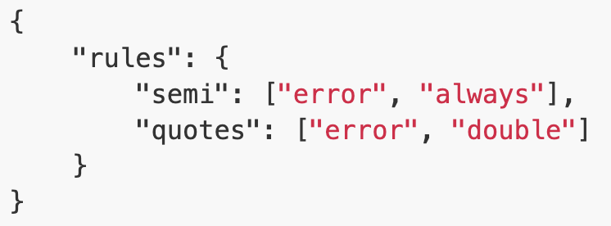
Getting started
npm install eslint --save-dev
npx eslint –init
npx eslint yourfile.js
.eslintrc file example

Slide 10
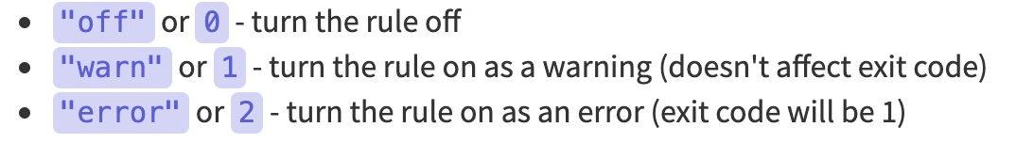
shortcuts

Slide 11
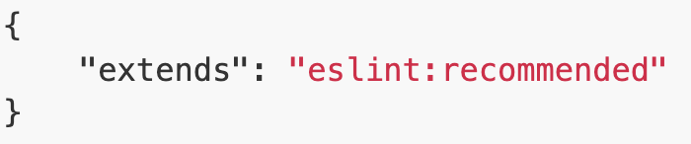
extending

Slide 12
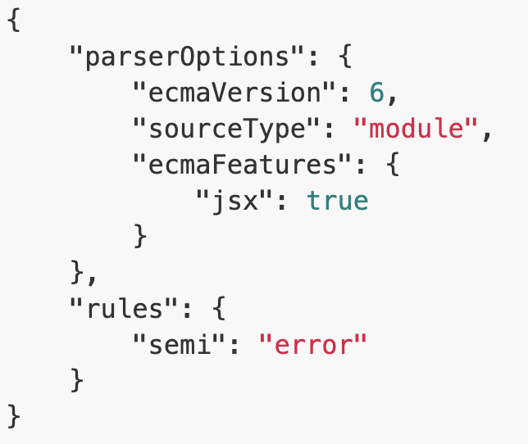
Parser

Slide 13

Demo

Slide 15
JSDoc
JSDoc is the de facto standard for documenting JavaScript code. You need to know at least its syntax (which is also used by many other tools) if you publish code. Alas, documentation is still scarce, but this post can help – it shows you how to run JSDoc and how its syntax works. (The JSDoc wiki is the main source of this post, some examples are borrowed from it.)
As a tool, JSDoc takes JavaScript code with special
/** */ comments and produces HTML documentation for it.

Slide 16
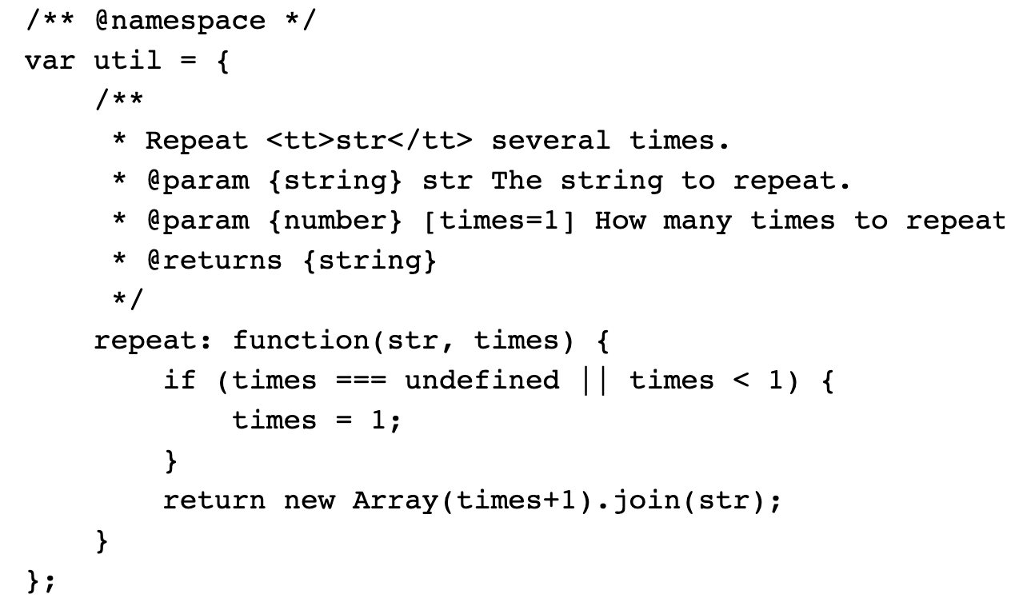
Example

Slide 17
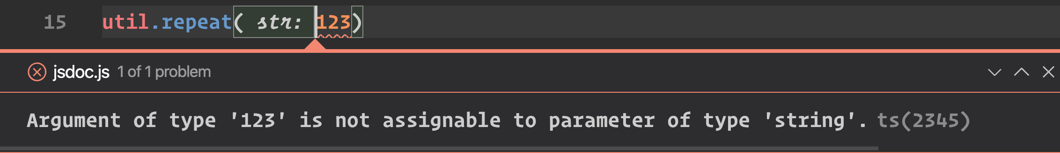
integration
VS Code have native integration with JSDoc. No need to generate HTML output file to see helper text
Put types to the using’s. if input parameter not match – VSCode generate an error(typescript will check your javascript)

Slide 18
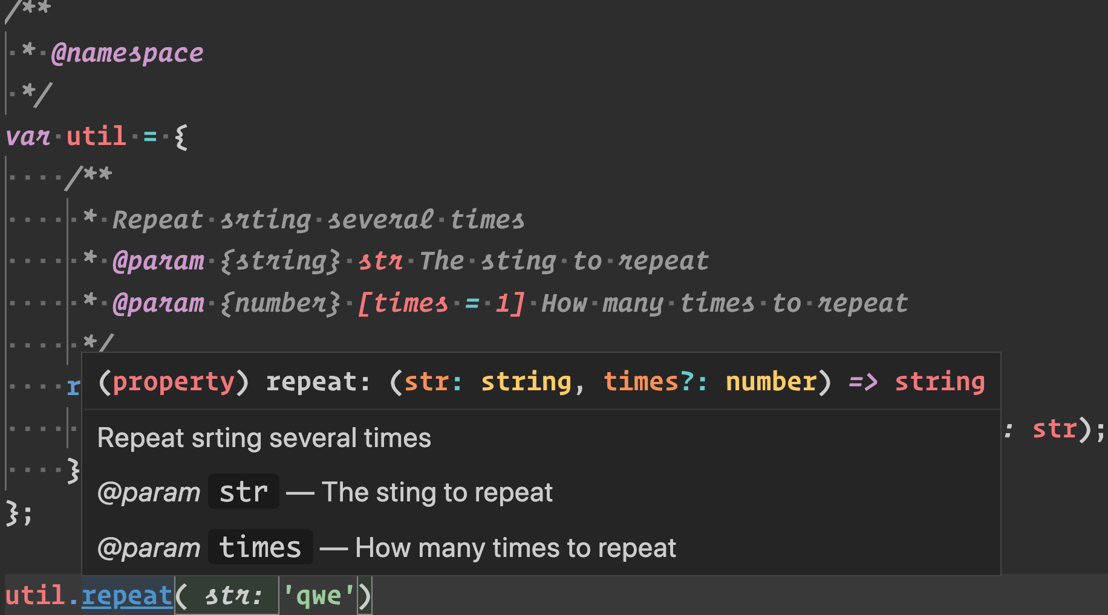

Slide 19
Most frequency used tags
@param
@example
@returns
@see
@link
@version
@author
@fileOverview

Slide 20
Demo

Slide 21
Commitlint
Validate git commit by criteria and do pre and post checks
helps your team adhering to a commit convention. By supporting npm-installed configurations it makes sharing of commit conventions easy

Slide 22
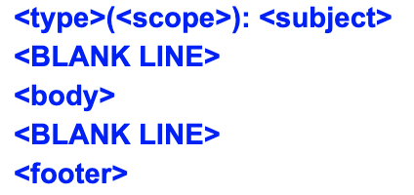
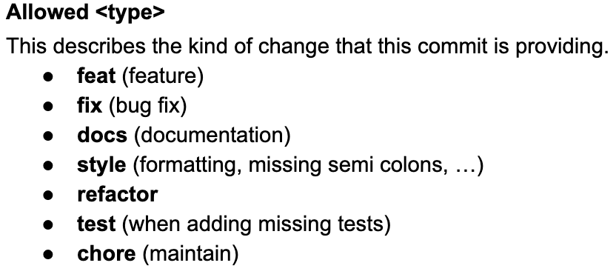
Example. Template

Slide 23
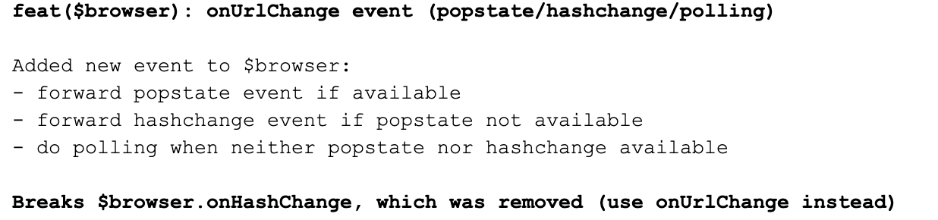
Examples. Git commit message

Slide 24
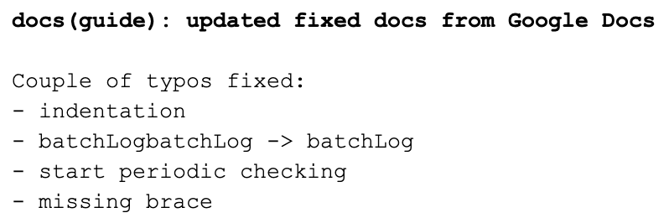
More examples!

Slide 25
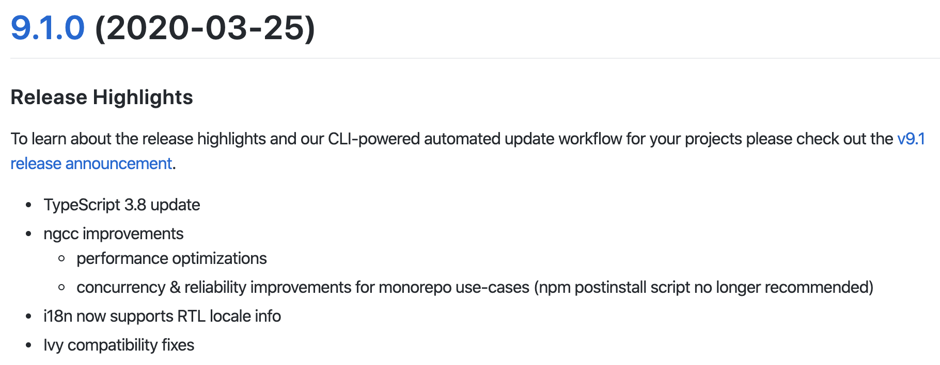
Autogenerated changelog
Angular changelog

Slide 26
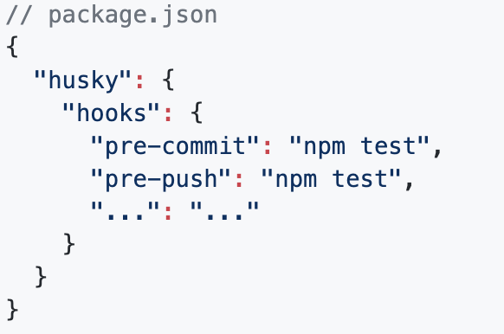
Husky
Git hooks made easy (C) Husky Team
npm install husky --save-dev
Run custom code by commit/push
Works well with commitlint

Slide 27
Demo

Slide 29
Prettier
An opinionated code formatter
Supports many languages
Integrates with most editors
No need to discuss style in code review
Saves you time and energy
Configuration file: .prettierrc and .prettierignore

Slide 30
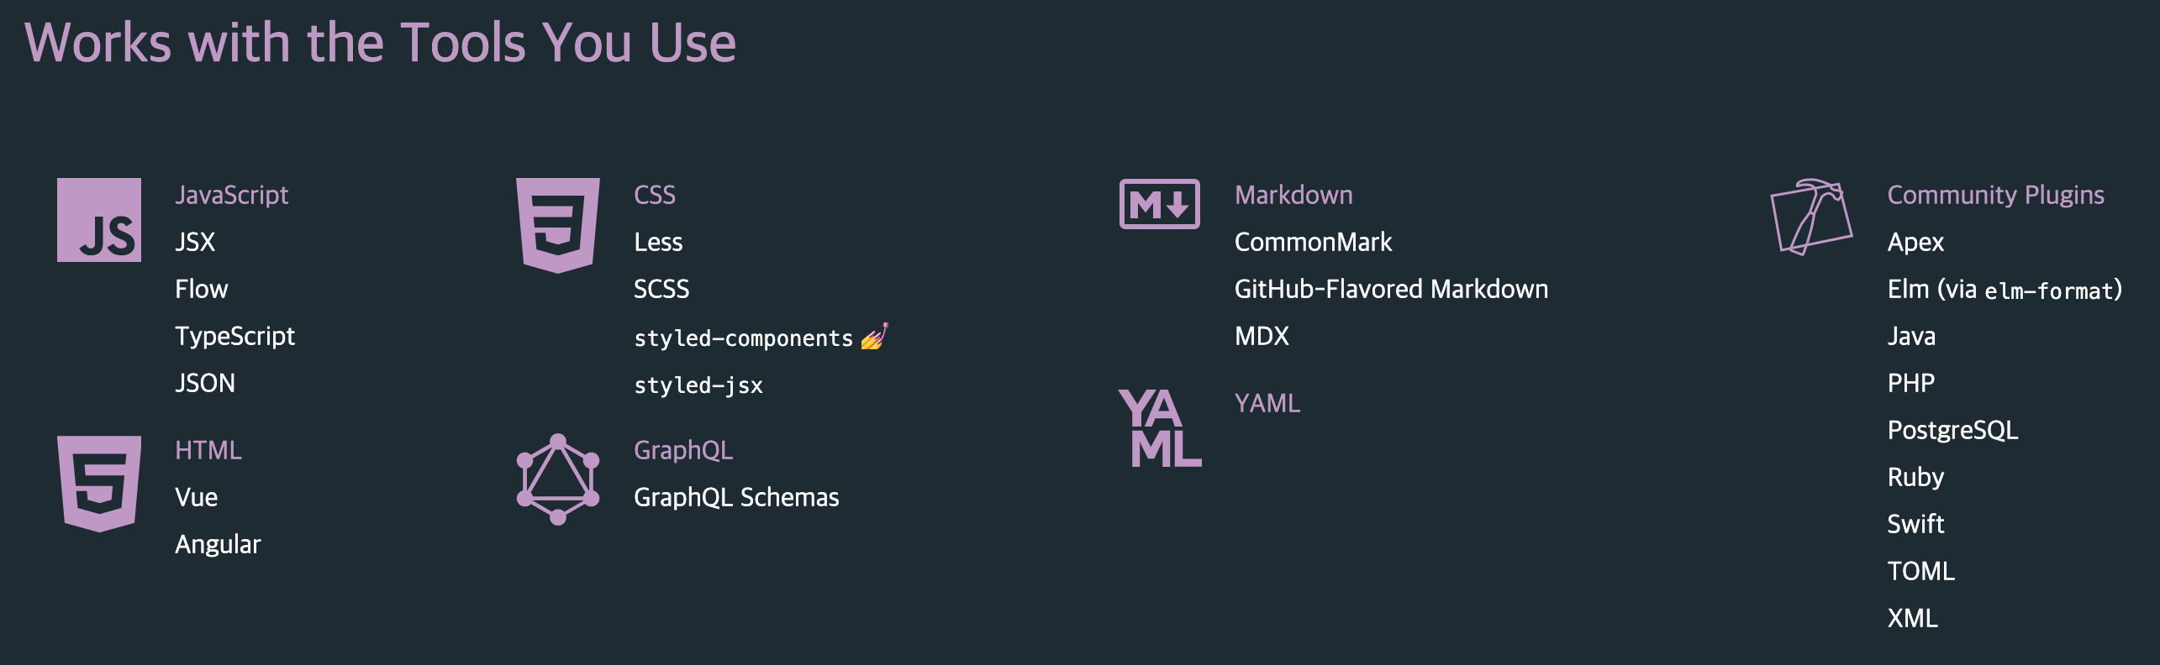

Slide 31
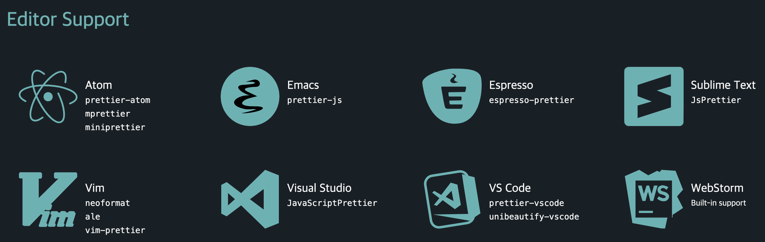

Slide 32
Getting started
npm install prettier --save-dev
npx prettier --write src/index.js
With husky:
npm install pretty-quick husky --save-dev

Slide 33
Prettier vs. Linters(ESLint, TSLint, etc.)
Linters have two categories of rules:
Formatting rules: eg: max-len, no-mixed-spaces-and-tabs, keyword-spacing, comma-style...
Code-quality rules: eg no-unused-vars, no-extra-bind, no-implicit-globals, prefer-promise-reject-errors...
Prettier extends these rules categories.

Slide 34
Demo

Slide 36
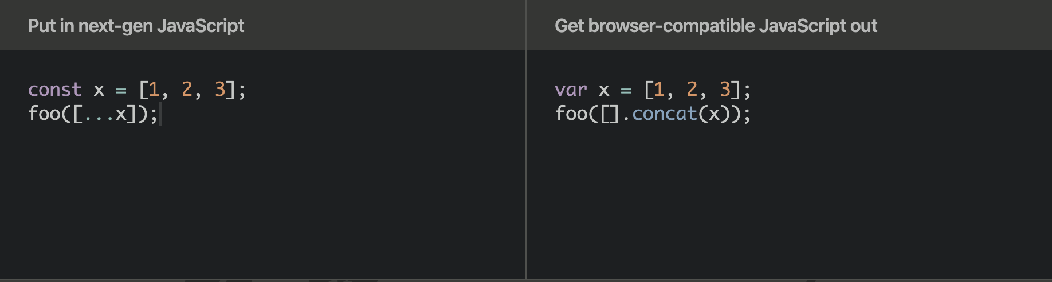
next-gen compiler?

Slide 37
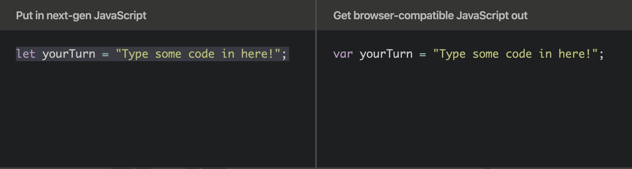
More examples

Slide 38
Use cases
When your environment require previous version JavaScript(Old browsers, old nodejs versions)
When you want to use ”fresh” javascript. Before new feature will be in the ECMA standart

Slide 39
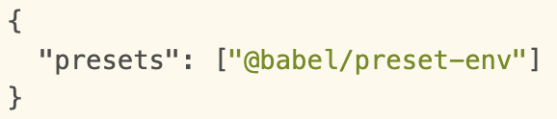
setup
npm install --save-dev @babel/core
npm install @babel/preset-env --save-dev
Create .babelrc
Paste next settings

Slide 40
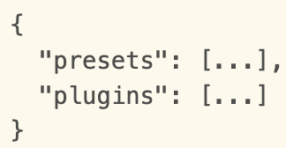
Necessary settings

Slide 41
Demo
Getting started
Playground

Slide 43
Short brief
JavaScript that scales
Starts and ends with JavaScript
Strong tools for large apps
State of the art JavaScript
Developed by Microsoft. First release - end of 2012(October)
Conceptually - JS is a valid TS
Current version – 3.8

Slide 44
JS that scales

Slide 45
What’s written in typescript
Typescript
Visual studio code
Typescript site
Angular
Types declarations(@types/react, @types/node)

Slide 46
Features
Type annotations
Type interface
Type erasure(remove types after compiling)
Interfaces
Enums
Generics
Tuples
Async/await

Slide 47
Get started
Npm install typescript –save-dev
Npx tsc --init
Npx tsc <file.ts>

Slide 48
Type system
number
string
boolean
object
T[] or Array<T> (where T - type)
undefined
null
void (same as undefined, but used for methods)
any(any type – we don’t know what is type. Never use. Exception – porting JS lib)
unknown(as any – but with type checking. ‘strict any’)
never – used for unreachable code blocks(such as exceptions)
Custom types

Slide 49
Demo
Getting started
Playground link

Slide 50
References
eslint
JSDoc
commitlint
Conventional commits
husky
Prettier
Babel
Babel playground
Typescript playground

